Slide 1
ATEC / a successful training approach in Lisbon region and Portugal
Lisbon Tech Week 22.06.2016

Slide 2
ATEC / Learning for life a successful training approach in Lisbon region and Portugal
Hans Jürgen-Müller Lisbon Tech Week 22.06.2016

Slide 3
/ Agenda
The challenge: Skills Mismatch
ATEC – Training Academy
Fast Track for Innovation call with CBTA and EAEC
Hans Jürgen Müller Lisbon Tech Week 22.06.2016 / www.atec.pt

Slide 4
/ The Challenge
Companies
DEMAND
Qualified technicians
Educational and Training System
OFFER
Skills mismatch
Conceptual offer
Few offer for emerging markets
Technological evolution
New markets
Slow reaction capacity
Lisbon Tech Week 22.06.2016 / www.atec.pt
Notes:
Companies face a great challenge related to the need of qualified technicians in many diferent areas due to a structural lack of qualified technicians that is increasing mostly because of:
(1) New markets (Smart Grids, Smart Cities, Industry 4.0) and all the new necessary skills related to them;
(2) Fast technological evolution.
In Portugal this challenge is even more importante as the educational and training system in Portugal (and other countries, as well) can’t deal in an efficient way with this evolution because:
(1) There are few available resources to deal with the fast changes of the market;
(2) Few qualifications offer for the emerging markets.
(3) Adding to this, the existing offer is mainly conceptual without a direct link to the companies’ needs, as we can find in other systems like in Germany with a strong link between Dual VET and Companies.
And this brings us to the great challenge of skills mismatch.

Slide 5
/ The Challenge
only in Portugal, there will be 15 000 vacancies for which there will be difficulty in finding people to fill
Given the urgency of rectify the labor shortage to meet the jobs that will exist in 2020 in the ICT sector is crucial to increase the supply of ICT professionals in Portugal and contribute to the development of national digital economy. A similar situation is experienced in the European Union, which the European Commission estimates that by 2020 there will be 900,000 unfilled ICT jobs without immediate corrective action.
Lisbon Tech Week 22.06.2016 / www.atec.pt
Notes:
On the ICT sector the problem is even bigger, because this is a very fast evolving sector.
Only in Portugal an estimation of 15.000 vacancies are foreseen, while in all Europe a shortage of 900.000 ICT professional are expected in 2020, as already mentioned during this seminar.

Slide 6
/ The Challenge
“On average, by 2020, more than a third of the desired core skill sets of most occupations will be comprised of skills that are not yet considered crucial to the job today, according to our respondents.”
In: (2016) World Economic Forum; The Future os Jobs - Employment, Skills and Workforce Strategy for the Fourth Industrial Revolution
Lisbon Tech Week 22.06.2016 / www.atec.pt
Notes:
Many different recent studies about Industry 4.0 states that a huge change in the skills needs will happen in the short term, increasing even more the mentioned challenge.

Slide 7
/ ATEC | Compromise
Develop competencies through qualification, programs and know-how transfer, using technologically advanced methods and equipment.
Strengthen industry and economy in general.
Contribute to the enrichment of the country, harnessing the growth of people and organizations.
Training Academy
Since 2004
non profit organization
public utility entity
Lisbon Tech Week 22.06.2016 / www.atec.pt
Notes:
But this is not new!
In 2004 the German companies were already facing this challenge in Portugal… and created ATEC.

Slide 8
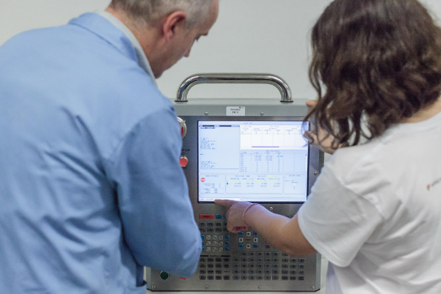
/ ATEC | Key figures
Since 2004
+ 80% employability
+ 12.500.000h vocational training
+ 4000 qualified teenagers
+ 2.000.000h training for companies
Lisbon Tech Week 22.06.2016 / www.atec.pt
Notes:
Since than, ATEC was able to…

Slide 9
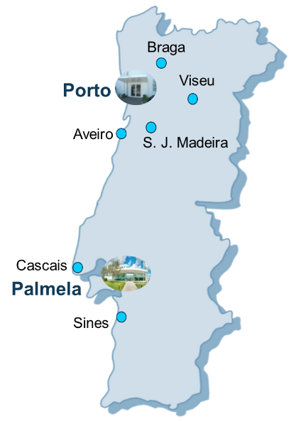
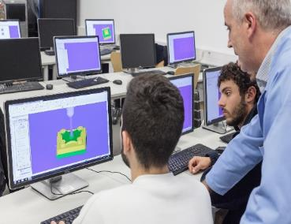
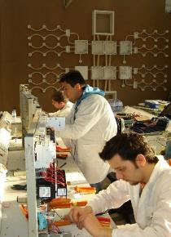
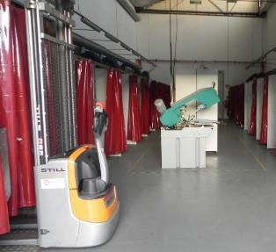
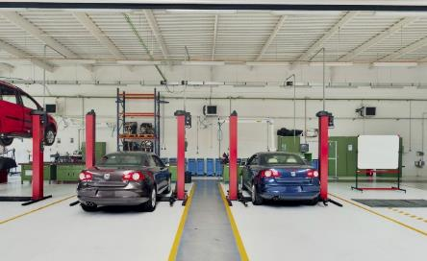
/ ATEC | People. Infrastructure. Equipment
Nationwide range to meet the needs of the industry for qualified people.
+ 1.200 full-time trainees
8 locations
14 workshops
34 laboratories
21 theoretical rooms
60 employees
+ 200 experts
Lisbon Tech Week 22.06.2016 / www.atec.pt
Notes:
And now also in Mozambique?!

Slide 10
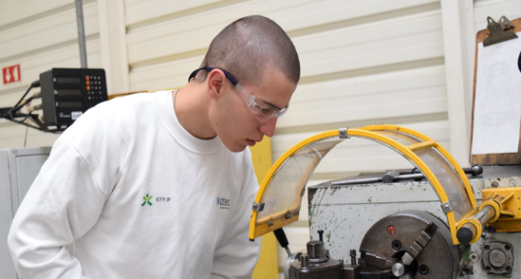
/ ATEC | Business
Vocational Training
Continuous Training
(for the market)
Lisbon Tech Week 22.06.2016 / www.atec.pt
Notes:
ATEC develops initial vocational training and continuous training for companies.
This gives us the ability of being in close connection with both Companies and the Educational and Training System.

Slide 11
/ ATEC | Business
Vocational Training in
partnership with:
Vocational Training
Apprenticeship
Technological specialization
Adult education and training
Lisbon Tech Week 22.06.2016 / www.atec.pt

Slide 12
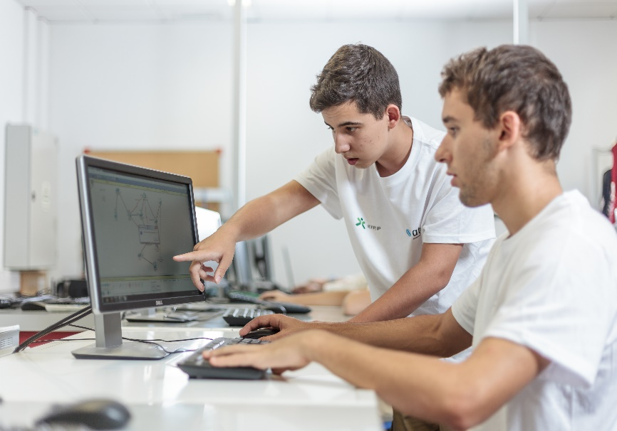
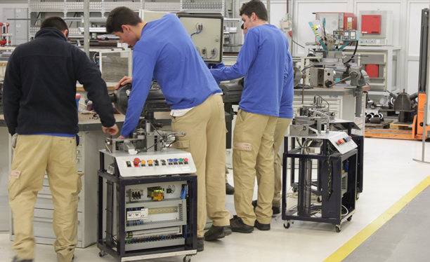
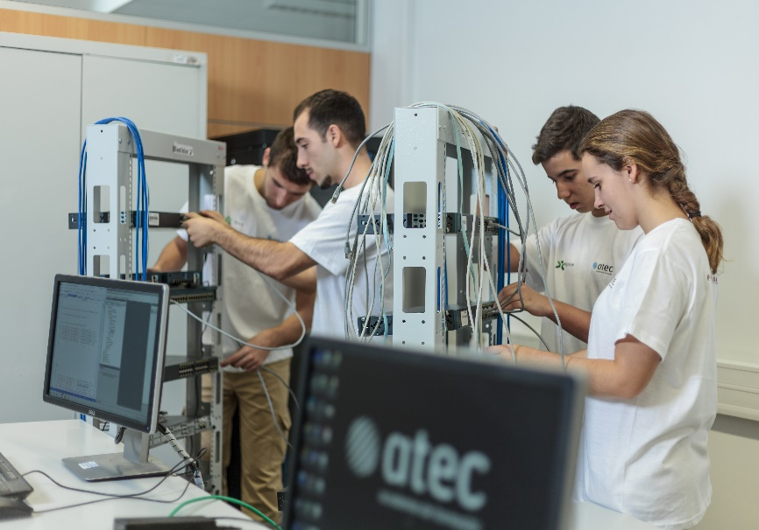
/ ATEC | Business | Vocational Training
Concept
Dual system
learn by doing
Lisbon Tech Week 22.06.2016 / www.atec.pt

Slide 13
/ ATEC | Business | Vocational Training | Training options
APPRENTICESHIP
Teenagers up to 18 years old
TECHNOLOGICAL SPECIALIZATION
Young adults up to 35 years old
ADULT TRAINING
Unemployed adults, over 23 years old
2,5 years long course
9th school grade concluded
12th school grade concluded
1 year long course
2 years long course
9th school grade concluded
Target Group
Certification
12th grade (mandatory schooling)
Professional Diploma – Level 4
12th grade (mandatory schooling)
Professional Diploma – Level 4
Professional Diploma – Level 5
Lisbon Tech Week 22.06.2016 / www.atec.pt

Slide 14
/ ATEC | Business | Vocational Training | Vocational Training Offer
APPRENTICESHIP
TECHNOLOGICAL SPECIALIZATION
ADULT TRAINING
Industrial maintenance
Mechatronics technology
Industrial maintenance
Car mechatronics
IT network management
Car mechatronics
Electronics, automation and command
Automation, robotics & industrial control
Automobile production
Electronics & telecommunications
Car mechatronics, planning and processes’ control
Welding
IT network installation & management
Telecommunications & Networks
Electronics, automation and command
Mechatronics
IT Technologies and programming
CNC machining & programming
Industrial Supervisor
Welding
Cybersecurity
Supported by:
Tool and Die
Smart Grids
Lisbon Tech Week 22.06.2016 / www.atec.pt
Notes:
Horizontal (not sectorial) technical offer with big advantages in what concerns to common challenges, different approaches, wider range of solutions

Slide 15
/ ATEC | Business | Vocational Training | Selection Process
APPRENTICESHIP
Psychometric tests
(written comprehension, numerical reasoning, spatial recognition)
Motivational interview
TECHNOLOGICAL SPECIALIZATION
Technical knowledge assessment test
Motivational interview
ADULT TRAINING
Psychometric tests
(numerical reasoning, understanding technical instructions)
Motivational interview
Group test
Avg. 3 : 1
Candidates : Vacancies
Lisbon Tech Week 22.06.2016 / www.atec.pt
Notes:
Focus on the trainee from the first day of contact with ATEC, also acting as a vocational guidance for the candidates, selecting the most adequate ones for the different offers.

Slide 16
/ ATEC | Business | Vocational Training | Training Paths
Apprenticeship and Adult training
University
2,5 years dual training
12th school grade
+
Professional Diploma
Labour Market
Technological Specialization Course
University
Labour Market
Lisbon Tech Week 22.06.2016 / www.atec.pt
Notes:
Different training paths available for the trainees.

Slide 17
/ ATEC | Business
Continuous Training
(for the market)
Training for
Companies and individuals
Automation & TI
Car Mechatronic & Industrial Mechanics
LEAN
Behavioral & Languages
Lisbon Tech Week 22.06.2016 / www.atec.pt
Notes:
Using the Promoters know-how ATEC can deliver transversal training programs to companies, guaranteeing the continuous actualization of individuals and companies’ staffs.

Slide 18
/ ATEC | Business | Continuous Training
Concept
To work towards customer needs with maximum flexibility and respect for the DNA of the company.
Lisbon Tech Week 22.06.2016 / www.atec.pt
Notes:
ATEC main activity is adapting the programs to the companies needs, acting in different areas of knowledge.

Slide 19
/ ATEC | Business | Continuous Training | Training Offer
Automobile
CNC
Industrial Maintenance
Mechanical Handling of cargo
Pneumatics & Hydraulics
Welding
Commercial
Organizational Development
Personal Development
Train the Trainer
Management Training
Foreign Languages
Human Resources
INDUSTRIAL MECHANICS & CAR MECHATRONICS
PERSONAL & ORGANIZATIONAL DEVELOPMENT
Automation
Electricity
Electronics
Information Technology
Energy Efficiency
Telecommunications
Robotics
Mechatronics
Project Management
Health & Safety
Ergonomics
Environment
Logistics
Methods and Work Organization
Quality
AUTOMATION & IT
LEAN
Lisbon Tech Week 22.06.2016 / www.atec.pt

Slide 20
/ ATEC | Business | Continuous Training | ATEC Academies
High specialization and complementary solutions for our trainees and costumers:
Cisco Academy Microsoft IT Academy SAP Academy Kaspersky Academy
ATEC became Pearson Vue and Certiport Examination Centre, allowing external certifications:
Lisbon Tech Week 22.06.2016 / www.atec.pt
Notes:
Specifically for the IT sector, our trainees and costumers have also available recognized training by the market at our Academies and can have their skills certified by external entities.

Slide 21
/ The problem | ATEC intervention
1 2 3
Companies Universities Associations
Lisbon Tech Week 22.06.2016 / www.atec.pt
Notes:
But facing the skills mismatch challenge demands a continuous effort from our team to innovate and follow the market needs.
ATEC intervention is than complemented with several partnerships with Companies, Universities and Associations.

Slide 22
/ ATEC | Clients & Partners
Lisbon Tech Week 22.06.2016 / www.atec.pt
Notes:
ATEC business demands a strong link with companies and a profound knowledge of the market needs.

Slide 23
/ ATEC | Partnerships with Universities
Cooperation protocols for technological specialization course.
Credit points equivalence to ATEC trainees who wish to proceed to university.
Creation of training programs in partnership.
Notes:
(2) Partnership with Universities for CET trainees and the development of innovative training courses and projects.

Slide 24
/ ATEC | Partnership with Associations
ATEC joined CPED which aggregates companies, the public sector, Universities, VET institutions and the civil society promoting initiatives in the field of digital employability, contributing to:
increase the search for qualifications in this area
reduce the skills mismatch between education and training and the market
Lisbon Tech Week 22.06.2016 / www.atec.pt
Notes:
(3) Partnership with associations and other entities which are paving the way for the market development
For the specific challenge of digital jobs, ATEC joined CPED in order to expand the ICT training to a wider public reducing the skills mismatch in this area.

Slide 25
/ ATEC| New skills for new jobs
Automobile Production Technician
(Level 4)
Car MechatronicsProcesses’ Management and Control
(Level 5)
Industrial Supervisor
(Level 5)
Production, Control and Energy Management
(Level 5)
Tool & Die Technician
(Level 4)
Welding Technician
(Level 4)
Training Units
Safety and Maintenance of electrical vehicles
In approval
Cybersecurity (Level 5)
2009
2012
2014
2014
2015
2015
2016
2016
Lisbon Tech Week 22.06.2016 / www.atec.pt
Notes:
From these partnerships, ATEC developed several new qualifications, that are now qualifying new technicians according to the companies’ needs. These are the most visible outputs from the work we’ve been doing in dealing with the challenge and that are contributing for the enrichment of the country.

Slide 26
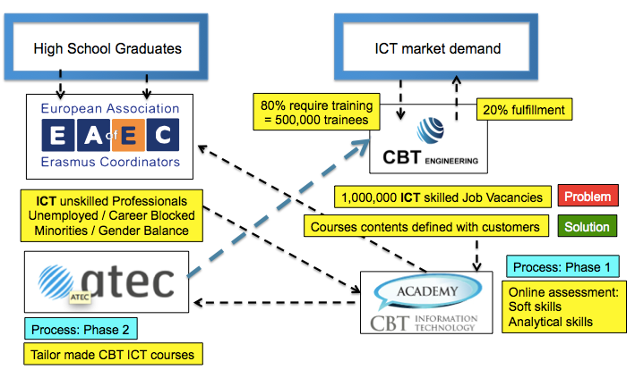
/ Fast Track for Innovation
ICT4Market
PROJECT CONCEPT
FTI Horizon 2020 project
Partners:
Lisbon Tech Week 22.06.2016 / www.atec.pt
Notes:
And finally, together with CBT and EAEC, in the scope of Horizon 2020 program we’ve just submitted the ICT4Market project to the Fast Track for Innovation call, in which we deposit great expectations.
Ricardo can explain a bit more what are the details of the project.

Slide 27
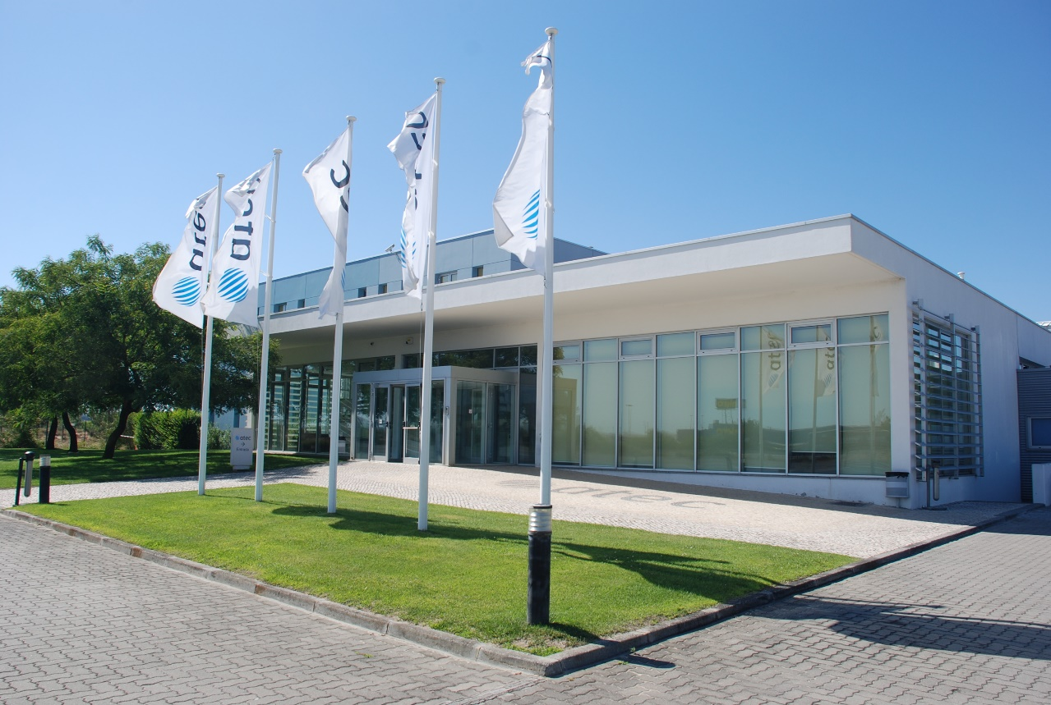
/ Contacts
Hans Jürgen Müller
hans.mueller@atec.pt
www.atec.pt

